Slide 1

Water Quality of NYC
By:
Aanal Bhavsar
N10123380

Slide 2
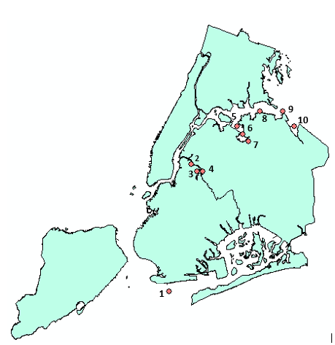
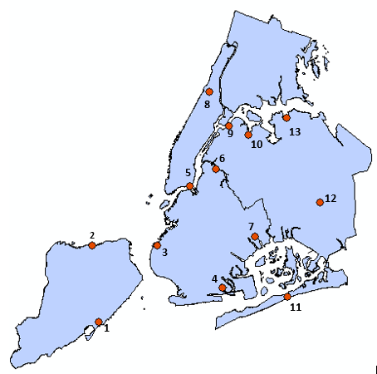
Water Quality Sampling Locations:
Sampling Stations in Harbor of NY
Waste Water Treatment Facilities of NYC
Oakwood Beach WWTP
Port Richmond WWTP
Owls Head WWTP
Coney Island WWTP
Red Hook WWTP
Newtown Creek WWTP
26th Ward WWTP
7. North River WWTP
8. Ward’s Island WWTP
9. Bowery Bay WWTP
10. Rockaway WWTP
11. Jamaica WWTP
12. Tallman Island WWTP
N9- Steeplechase Pier (Hudson Transects)
NC3-Whale Creek (Tributaries)
NC2-Amoco Tank Farm
NC1-Maspeth Creek
E6-Flushing Bay (East River)
6. FB1- Flushing Bay North
7. FLC2- Mouth of Flushing Creek (Tributaries)
8. E7- Whitestone Bridge (East River)
9. E8-Throg's Neck Bridge
10.E11-Little Neck Bay

Slide 3
Water Testing Parameters:
Some of the major parameters that are studied in this project are:
Dissolved Oxygen (DO):
Amount of oxygen present in water
Depicts water quality
Effects by temperature, salinity etc.
Limit < 18 mg/l
Ideal for aquatic species: 4-6 mg/l
Fecal Coliform:
Is a facultative anaerobic bacteria
Can be effected by precipitation
Comes from human and animal fecal waste
Enterococcus:
- Is a group of fecal bacteria
- Indicates extent of fecal contamination of recreational surface waters
- Can cause skin diseases
- Can survive in water with more DO

Slide 4
Strategies used:
Study Period: 2009-2015, monthly observation
Parameters Considered: DO, Fecal Coliform, Enterococcus
11 sampling stations divided into 4 clusters based on location
Each group has 1 or 2 Waste Water Treatment Plant(s) (WWTP)
Concentration of each parameter at monitoring stations is compared with temperature, precipitation and discharge concentration of WWTP
Developed heat map to visualise variation of each parameter, in ArcGIS

Slide 5
Divisions of Sampling Stations based on Location:
Group A: Coney Island Station N9 of Hudson Transects Nearby WWTP: Coney Island | Group B: In tributaries between Brooklyn and Queens Borough - Stations NC3, NC2, NC1 present in Tributaries - Nearby WWTP: Newtown Creek, Red Hook
Group C: Of East River Stations E6, FB1, FLC2 Nearby WWTP: Bowery Bay, Ward’s Island | Group D: Stations E7, E11 covering eastern uppermost portion of NYC Nearby WWTP: Tallman Island

Slide 6
Group A:

Slide 7
Group B:

Slide 8
Group C:

Slide 9
Group D:

Slide 10
Outcomes of Study:
DO decreases with increase in temperature
Fecal Coliform and Enterococcus are dependent on each other
Both biological parameters increases with precipitation
Results shows that Stations NC2 (Amoco Tank Farm)and FLC2 (mouth of Flushing Creek) recorded maximum concentration of Coliform and Enterococcus i.e avg around 50,000(/100ml)
Fecal Coliform concentration in these tributaries is more as there is no chlorination in the lakes which flows from here
These creeks receive 1 million gallons of raw sewage and storm river runoff annually
Animated Movie showing variation in parameters with time:

Slide 11
Table of Summary:
Stations | Range of Fecal Coliform(#/100ml) | Range of Enteroccocus(#/100ml) | Comment
N9 (Hudson Transects) | 500 | 200 | Acceptable
NC2 (Tributary between Brooklyn and Queens) | 65,000 | 10,000 | Measures to be taken
FB1 (Flushing Bay North) | 2000 | 2000 | Moderate
E15 (Tributary) | 6000 | 10,000 | Higher side
FLC2 (Mouth of Flushing Creek Tributaries) | 35,000 | 17,000 | Measures to be taken
E7 (East River) | 900 | 160 | Acceptable
E11 (Little Neck Bay) | 500 | 400 | Acceptable
Comment: Overall water quality of NYC has almost remained consistent from year 2009-2015

Slide 12
Thank You!!!

